Slide 1
Test Driven Development with MS Test
Crystal Tenn
Crystal.Tenn@microsoft.com

Slide 2
What is Azure Batch Service?
Notes:
Benefits of containers include: Density and agility, enabling agile application development and deployment
Don’t mistake Hyper-V container with a VM – containers are much more agile (deploy with a flip of the bits, etc.)

Slide 3
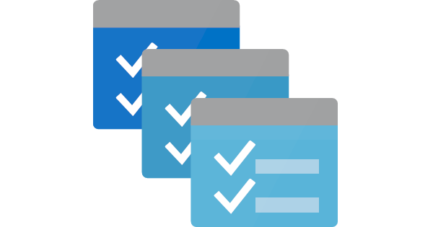
What is Azure Batch Service?
A platform service for running large-scale parallel and high-performance computing (HPC) applications efficiently in the cloud.
Azure Batch schedules compute-intensive work to run on a managed collection of virtual machines, and can automatically scale compute resources to meet the needs of your jobs.

Slide 4
Demo 2
Persisting Data from Azure Batch Service to Azure Storage
Notes:
End 37 mins

Slide 5
AutoScale
Notes:
Benefits of containers include: Density and agility, enabling agile application development and deployment
Don’t mistake Hyper-V container with a VM – containers are much more agile (deploy with a flip of the bits, etc.)

Slide 6
Azure Batch Service Lab

Slide 7
Thank you!

